Slide 1
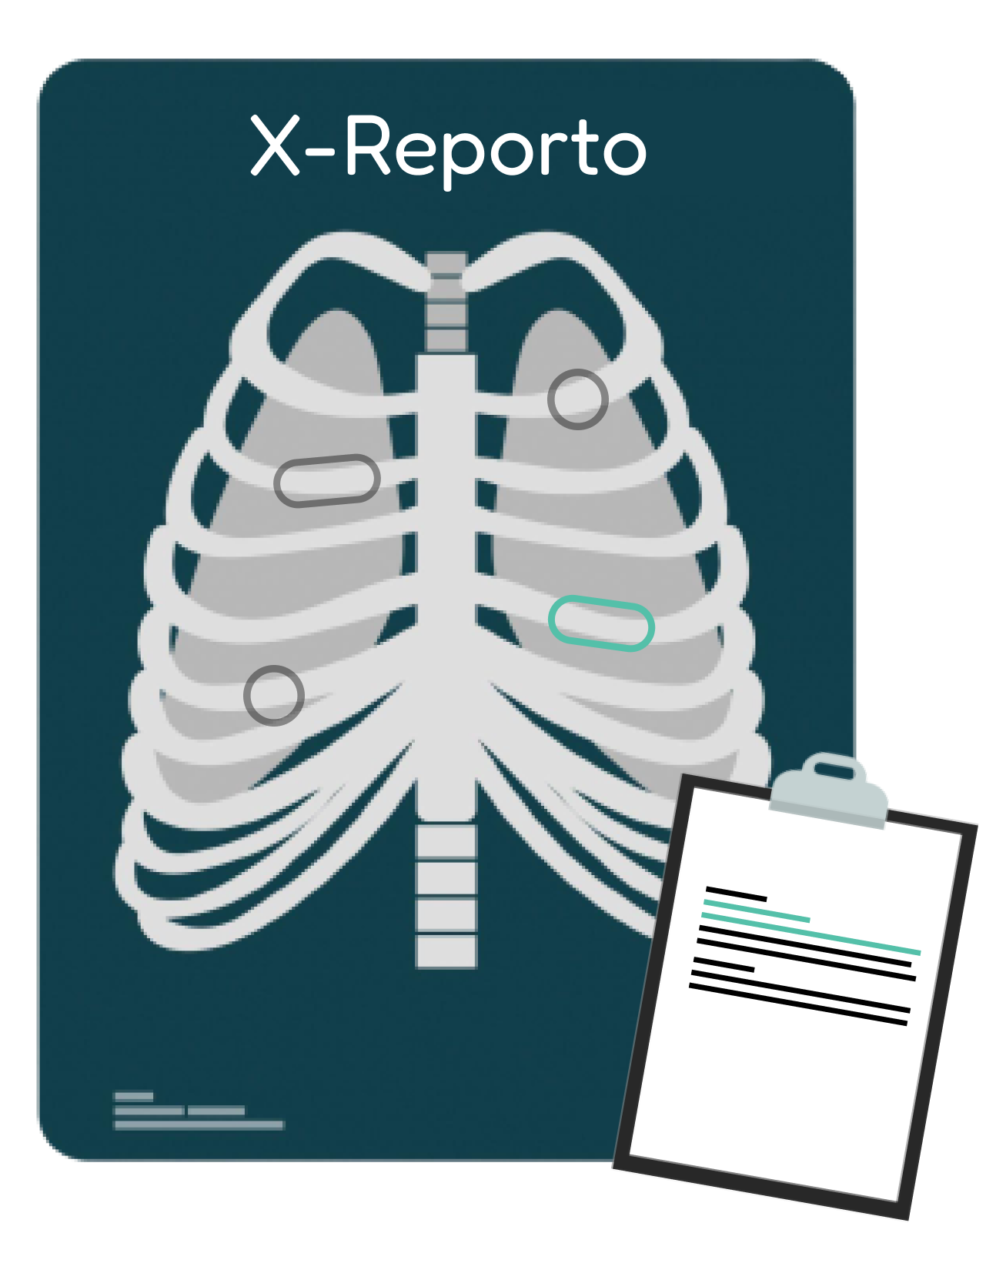
X-Reporto
Supervisor: Dr. Yahia Zakaria
Presented by:
Ahmed Hosny
Ahmed Sabry
Basma Elhoseny
Zeinab Moawad

Slide 2
Table of contents
Problem
Market
Modules
Workload
01
03
05
07
02
04
06
08
Motivation
Our Tool
Challenges
Timeline

Slide 3

01
Problem Statment

Slide 4

Problem Statement
Millions of chest X-rays need to be examined by Radiologists.
In developing regions, can not properly train new radiologists.
Notes:
Large no. of X-rays + low no. of radiologists
In developing regions, These areas often don’t have the resources to fully support their healthcare systems or to properly train new radiologists.

Slide 5
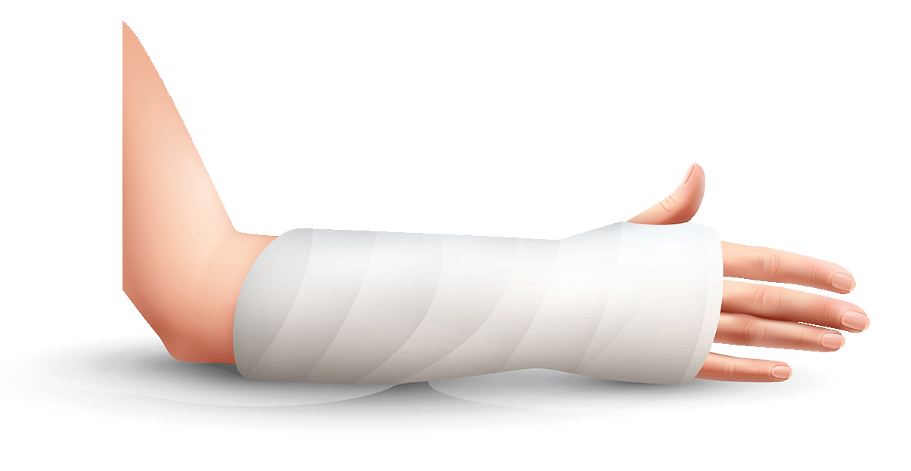
02
Motivation

Slide 6

Motivation
Shorten the time it takes for radiologists to diagnose patients
More serious cases need to be examined first
Fix Noisy X-ray due to hardware
Voyance Medical
Notes:
Why thought about this problem ? Voyance Medical (meetings)
Shorten the time it takes for radiologists to diagnose patients
Many X-rays are waiting in queue, and the more serious cases need to be examined first.
X-ray may have noise so the clearer x-ray the more accurate result.

Slide 7

03
Market
Similar Tools

Slide 8
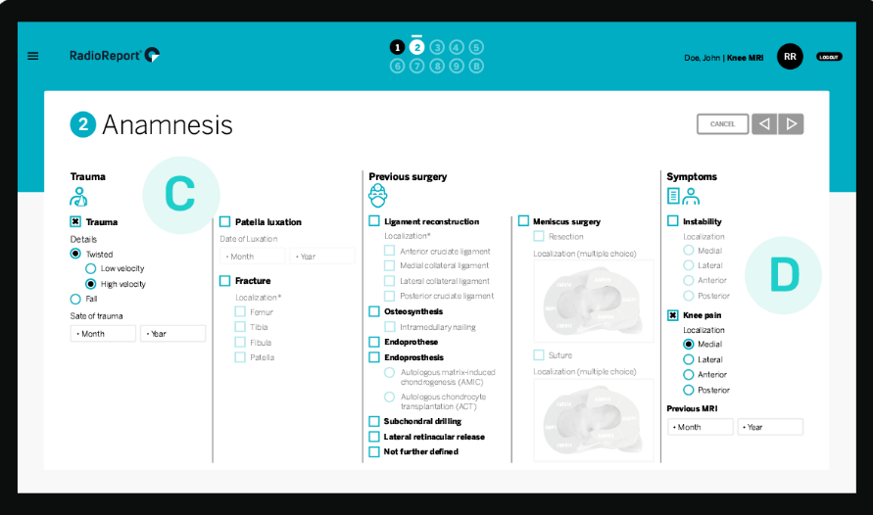
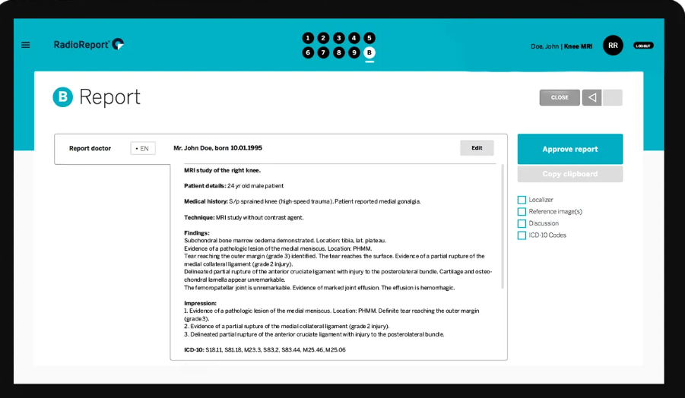
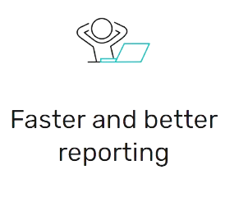
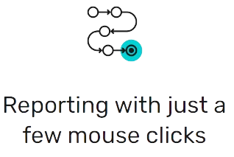
Market Solution
Radio Report
A virtual interview to generate the final report
Notes:
The software guides you like a virtual interview to the final reports → Choose instead of writing
Still Radiologist must seat to help him in writing → like form he is writing [output]
No AI

Slide 9
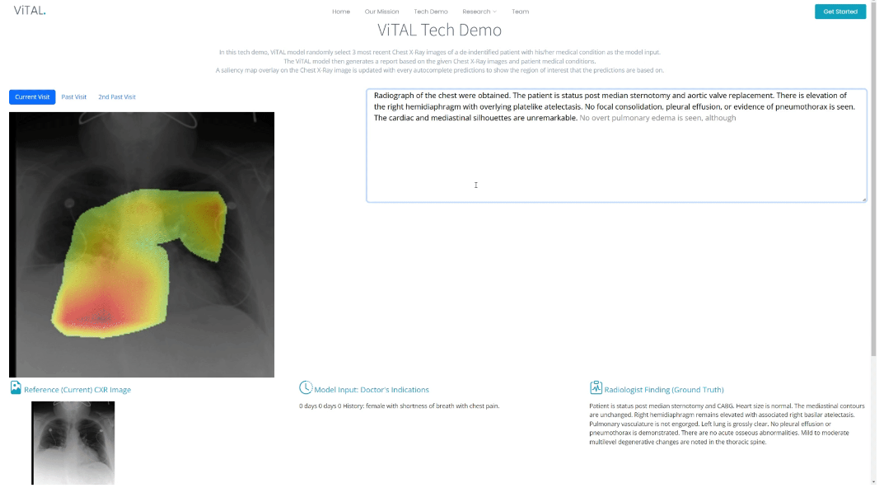
Market Solution
ViTAL
Annotation tool that provides sentence completion suggestions
Notes:
Berkley University Research New Search Summer 2023
Annotataion tool that provides sentence completion suggestions
Like Gmail

Slide 10
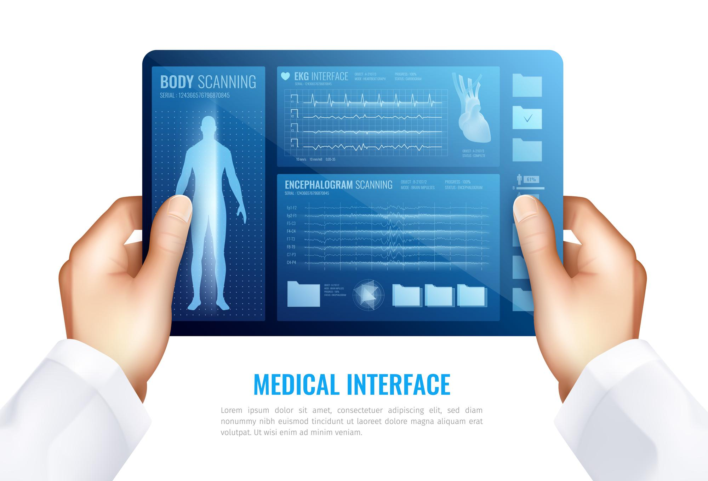
04
Our Tool
Notes:
What about our tool ?

Slide 11
Our Tool
AI-Solution to automatically diagnose chest x-ray and report generation.
Features:
Noisy X-ray Enhancement
Region Based Report
Initial Complete Report
Region Annotation and Text Editing
Notes:
AI-Solution to automatically diagnose chest x-ray and report generation
Fixing Noisy X-ray due to hardware defects → better quality
Region Based Report → Report understanding referring text to the defected region
Initial Complete Report is generated → just he checks it [Not from scratch]
He Can modify the regions on which report is generated and edit report

Slide 12
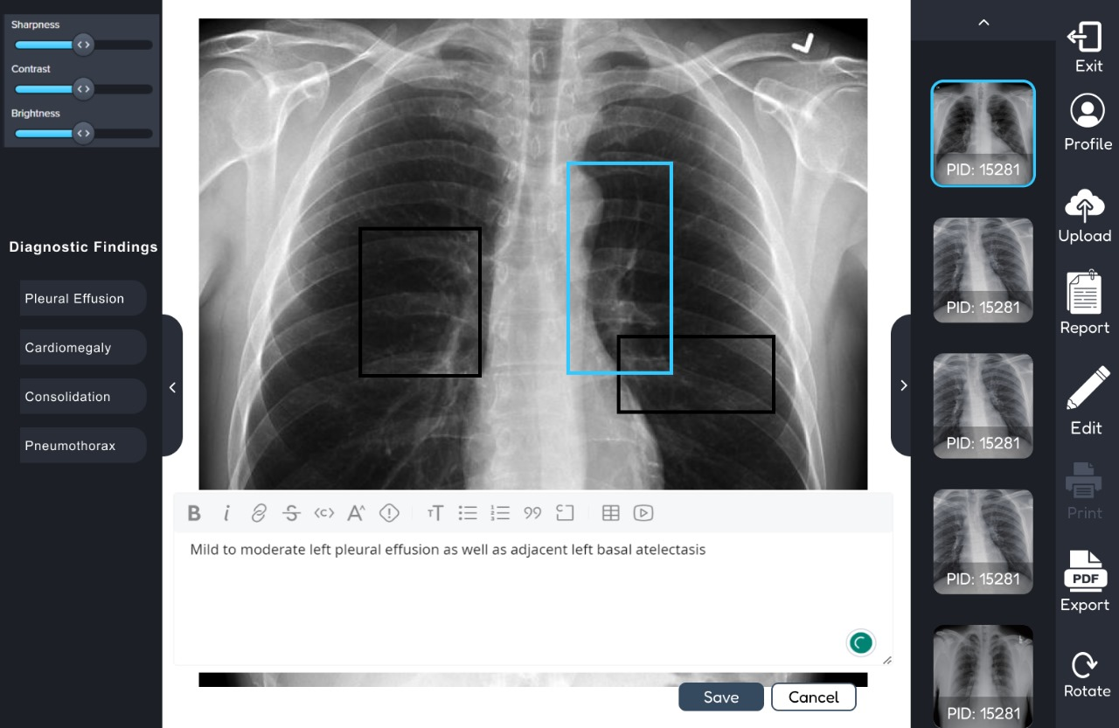
X-Reporto
Notes:
Arranged by Priority
X-ray image is loaded

Slide 13
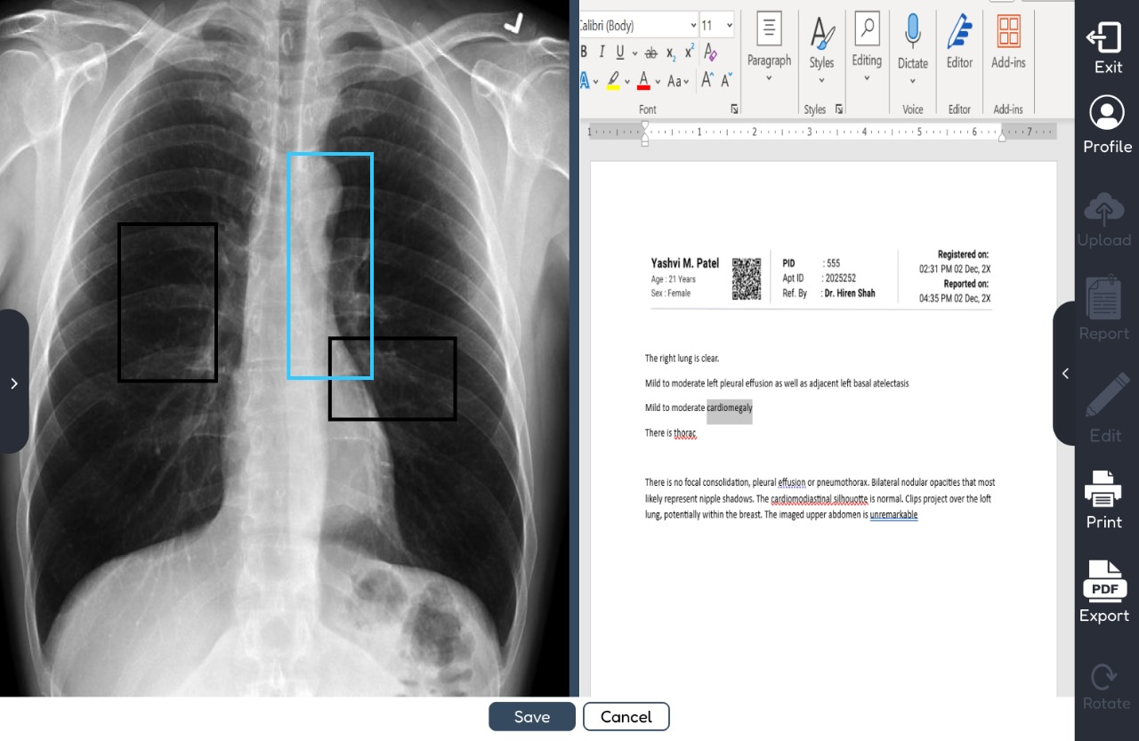
X-Reporto
Modes of Operation:
Full radiology report
Anatomy-based sentence generation
Notes:
Full Report
What regions are examined ? 29 Region منطقه تشريحيه
Final Report Being Generated → Refer to Region for each sentence
2 Modes of operation in the region being examined
Model chooses regions
Radiologist choose regions

Slide 14



Overview
AI
Aid Level | HIGH | MEDUIM | LOW
Editing
Denoising Image
Notes:
2 only

Slide 15
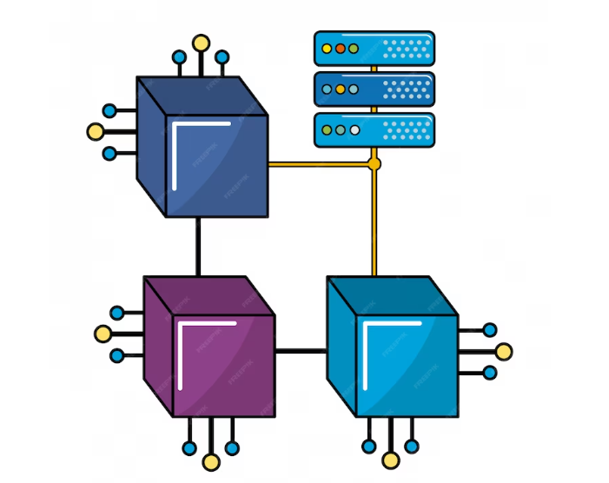
05
Modules

Slide 16
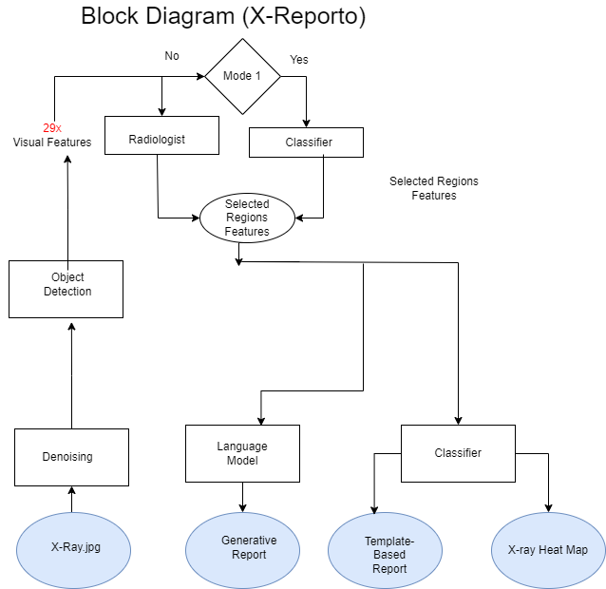
Flow Diagram

Slide 17
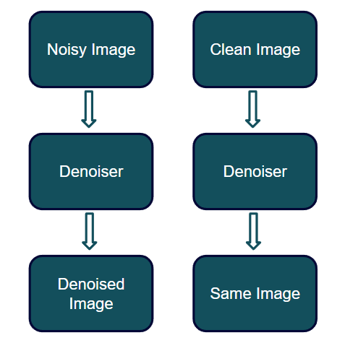
Denoising
Remove device noises occurring while generating X-rays.
Distinguish between noisy image and clean image.
Differentiate between noise and relevant medical information.
Classical filters - GANs.

Slide 18
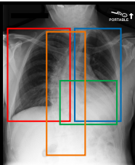
Region Detector
Detect anatomical Regions in chest to generate corresponding line in report on its abnormal regions
Classical (SIFT+SVM) - Faster R-CNN – Yolov5

Slide 19
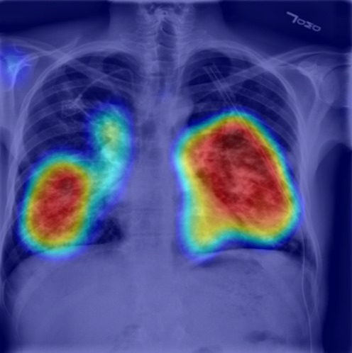
Multilabel Classifier
Classify each region if it’s abnormal or not.
Detect possible diseases in each abnormal region.
Generate heatmap for disease location.

Slide 20
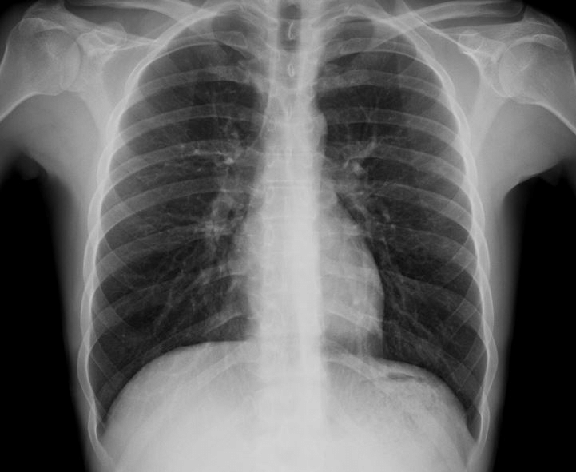
Report Generator
Generate full medical report that truly describes X-Ray image.
Rule-based & Generative AI Approaches
GPT2 – BERT Decoder.
Report
Comparison: None.
Indication: Chest pain, feels out of it.
Findings:
The Cardiomediastinal silhouette and pulmonary vasculature are wining normal limits in size.
The lungs are clear of focal airspace disease, pneumothorax, or pleural effusion.
There are no acute bony findings.
Impression: No acute cardiopulmonary findings

Slide 21

06
Challenges

Slide 22
Challenges
Reference Report
there is persistent apical pleural thickening and apical scarring. Linear opacities projecting over the lower lobe are also compatible with scarring, unchanged. There is no left pleural effusion. There is no pneumothorax. …
Evaluation metric.
It’s a medical problem not NLG problem.
Evaluate on correct medical observations.
Generated report must be consistent with the output of classifier.
Input image may be clean so the denoising module
should not remove relevant medical info.
Generated Report
. Bilateral pleural effusions are again noted and have increased in size on the right than the left. The left-sided pleural effusion has increased in size and is now derate in size

Slide 23

07
Workload

Slide 24
Workload
Denoiser | Ahmed Sabry
Region Detector | Ahmed Hosny
Multilabel Classifier | Basma Elhoseny
Report Generator | Zeinab Moawad
Integration | All Members

Slide 25

08
Timeline

Slide 26
Timeline
Research
Testing
Deployment
Jan – Mar
April
May
June
Aug – Sep
Oct – Dec
Aug. – Sep.
Aug. – Sep.
Idea
Implementation
Integration

Slide 27

Thanks
Any Questions ?!

Slide 28
09
Appendix

Slide 29
Security
Under Research
Due to sensitive data [Remove Meta Data only]
Security for Data – Model – Use of Model

Slide 30
Feed back
Under Research
Model Makes Errors
The Doctor Correct them
Model relearns from corrections

Slide 31
Mode 3
Radiologist draw boxes around the region he want to report it
The model must approximate his drawing to the nearest anatomical regions
It will be sensitive to position and scaling (Challenge)
Robust to shape of box
No Metric to evaluate this Mode

